Slide 2
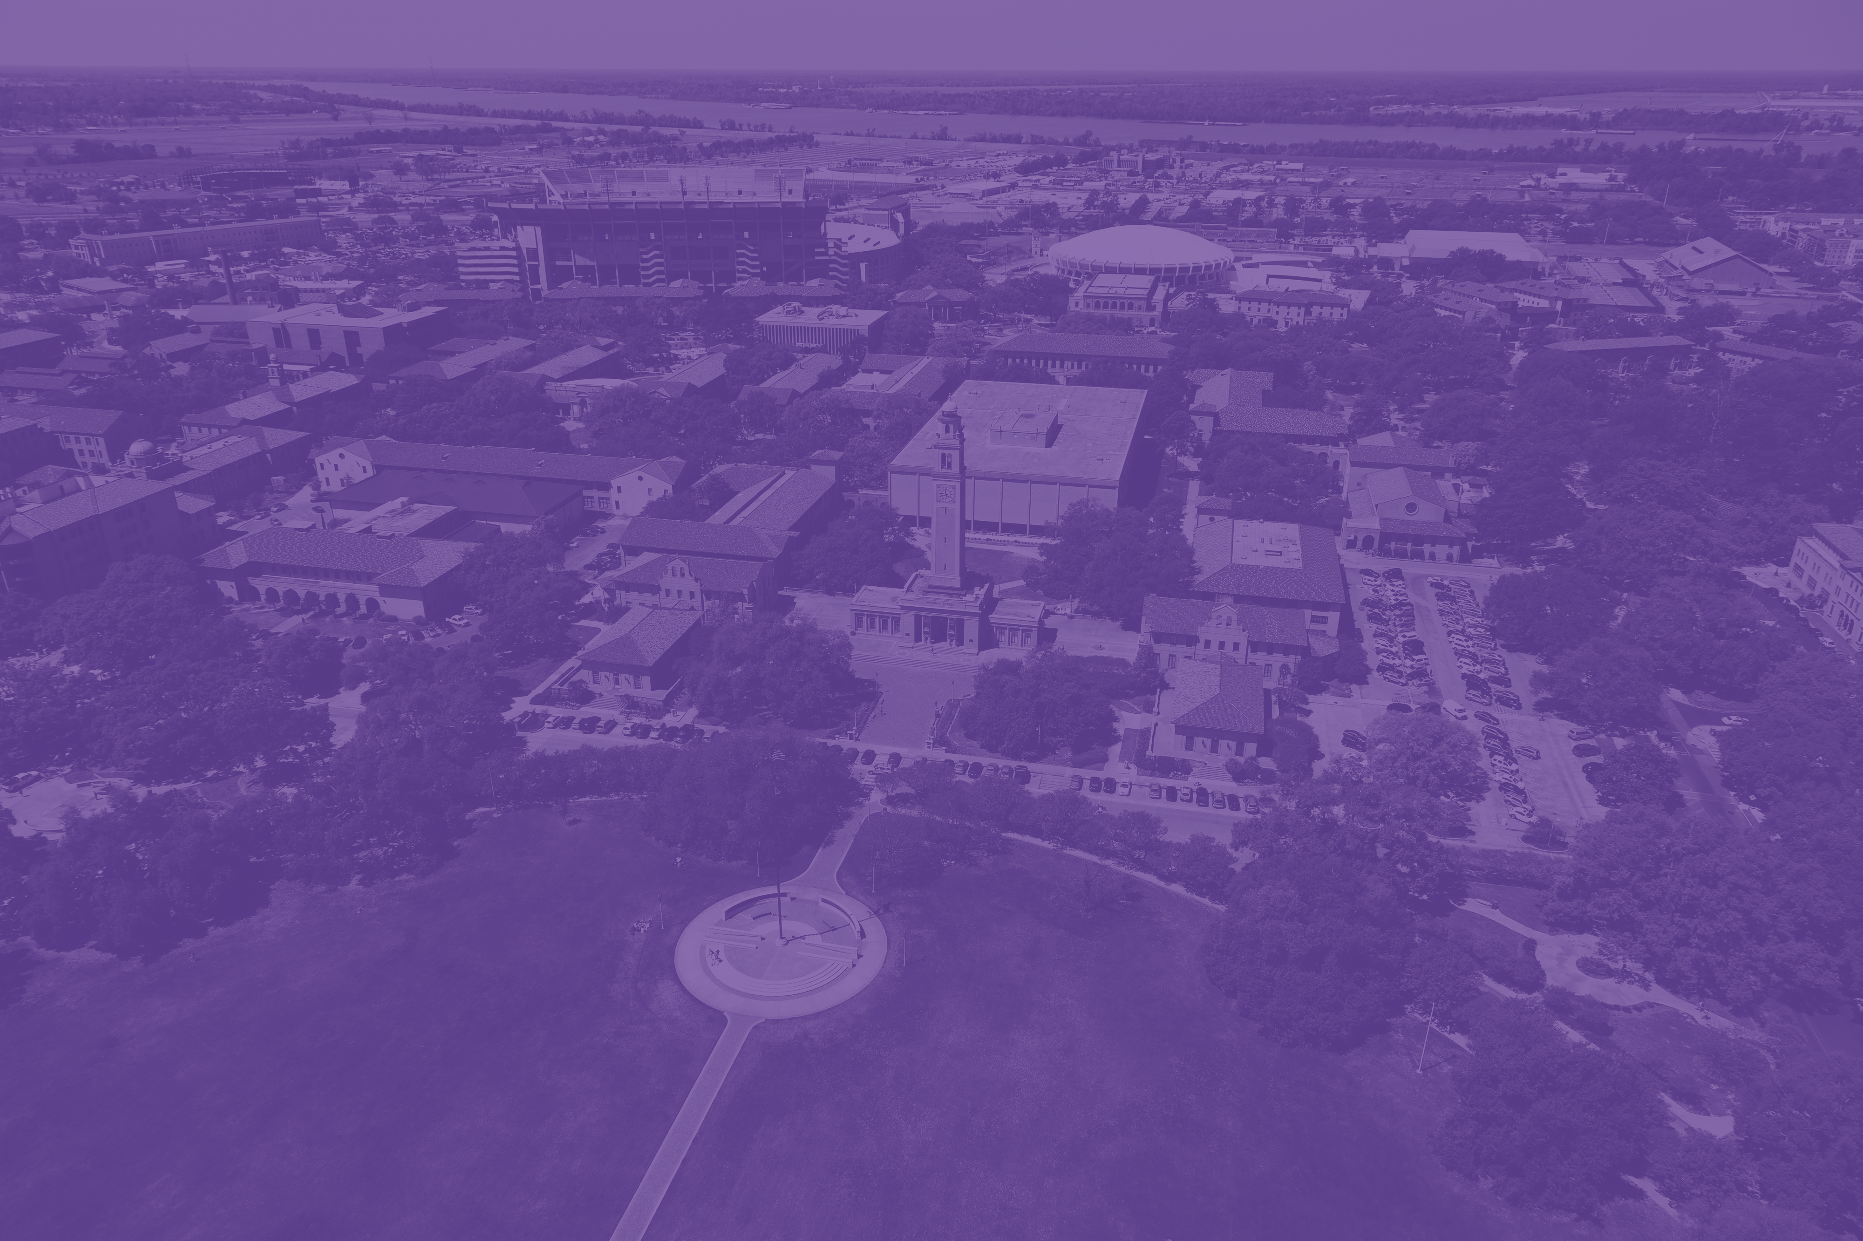
Multi-factor Authentication (MFA) at LSU
Overview

Slide 3
Agenda
About MFA
MFA Timeline and Rollout
Major Issues and Solutions
MFA Best Practices
Support Mechanisms
General Security Best Practices

Slide 4
About Multi-factor Authentication (MFA)
MFA is the most effective way to protect accounts from malicious sign-ins
According to Microsoft, enabling MFA stops 99.9% of attacks
MFA works by requiring something you know (like a password) and something you have (like a mobile phone) to log in.
Without access to both factors, malicious actors cannot sign-in to an account to steal data or send phishing messages

Slide 5
MFA Project Timeline
Fall 2018 – Review Security enhancements for Office 365. Identification of MFA as an enhancement.
Spring 2019 – Testing MFA scenarios and usage, creation of documentation, roll-out schedules/plans.
May 2019: MFA enrollment and enforcement for ITS employees
Summer 2019 – MFA enrollment and enforcement of all administrative units.
Meetings with College/Department TSPs for scheduling MFA roll-out of academic units
Fall 2019 – MFA enrollment and enforcement for all students
Fall 2019 and Spring 2020 – MFA enrollment and enforcement of academic units
April 2020 – MFA roll-out complete for all eligible accounts (approx. 55,100 accounts)

Slide 6
How was MFA rollout planned?
ITS created a packet of GROK articles, communication plans, instructional videos for end users.
Distribution and communication through College/Departmental TSPs
Each departmental rollout was scheduled over 4 weeks and conducted by TSPs or ITS staff:
Week 1: Email outreach
Week 2: MFA enrollment
Week 3: Continued outreach, optional workshops
Week 4: MFA enforcement

Slide 7
How was MFA rollout planned?
ITS conducted over 30 meetings throughout the last year with TSPs and other stakeholders to walk through MFA rollout, usage, and impact
Members of ITS conducted over 25 MFA enrollment workshops to help faculty and staff on-location (in coordination with College/Department TSP).
Continuous feedback from TSPs and end users was incorporated to create or improve documentation.

Slide 8
Issues and Solutions
Created MFA troubleshooting article to address common issues TSPs and users were facing:
iOS default client issues
Phone call issues
Frequency of notifications
Travelling users
Use of Validation Codes
MFA Resets
New devices
Office phones
MFA Outage
Temporary rollback

Slide 9
MFA Best Practices
Use the Microsoft Authenticator app
Enroll with multiple factors
Primary phone and separate alternate phone
Authenticator app or code generator on multiple, distinct devices
Use factors you expect to have access to when signing in
Don’t approve login requests if you’re not currently trying to sign in!

Slide 10
Support Mechanisms
ITS worked closely with TSPs throughout rollout to assist users directly
The FTC and Service Desk staff are available to help answer MFA questions
GROK articles are available and modified based on feedback and new issues
New enrollment experiences are being tested to improve end user experience.
GROK Articles:
Logging in with MFA - https://grok.lsu.edu/Article.aspx?articleid=19930
MFA Enrollment - https://grok.lsu.edu/Article.aspx?articleid=19929
MFA Troubleshooting - https://grok.lsu.edu/Article.aspx?articleid=19960

Slide 11
General Security Best Practices
Use unique passwords for your accounts; do not reuse the same password across sites
Make sure your device’s operating system is up to date
Make sure your applications (Office, Adobe Reader, web browser, etc) are up to date
Make sure your device’s firewall is active and you are using anti-malware protection (like Windows Defender or Symantec Endpoint Protection)
Be mindful of how you store and share sensitive data
Watch out for email scams and phishing. Report suspicious messages through the Cofense Reporter or by emailing security@lsu.edu.

Slide 12
Questions?

