Slide 1
©
Copyright and Scholarly Communications Services Middleton Library
Notes:
Stanley brought me to LSU as part of his vision
to make the Libraries a full service partner
supporting all phases of the research lifecycle

Slide 2
Copyright Services
Fair Use
Permissions
Ownership of Self-CreatedWork at LSU
TEACH Act
General Copyright Information
Notes:
Fair Use - MPAA, book author
General Copyright - Oxford - Josephine Baker
Educational Exception - different rules for ground vs online, assist with resources

Slide 3
Scholarly Communications
Services
Creative Commons Licenses
Contract Terms
Negotiation Tips
Notes:
OA CC Certified
Contracts and Fox
Negotiation and empowerment

Slide 4
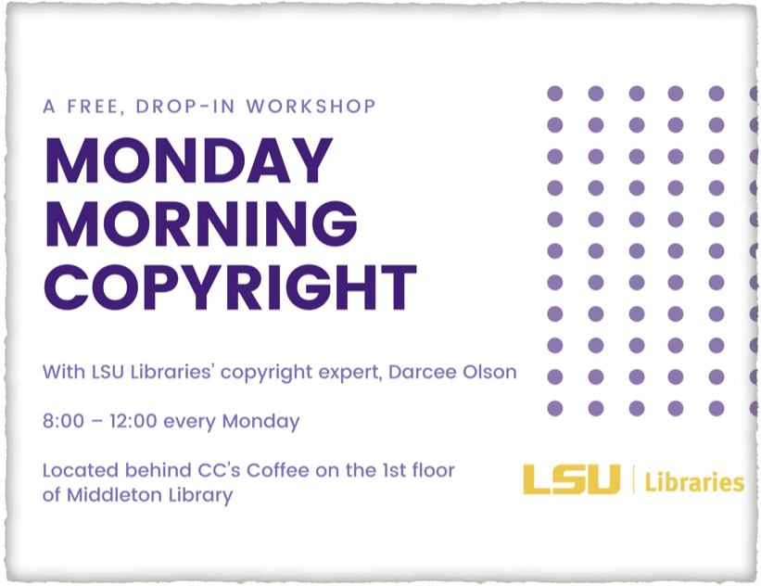
Drop in workshop

Slide 5

Laying down the beats

Slide 6
Darcee contact info
Darcee Olson
Copyright and Scholarly Communications Policy Director
Zoom Office Hours
Monday, Tuesday, Thursday 8-12
Dean’s Office - Middleton Library
Louisiana State University
olson1@lsu.edu
225-578-1981

