Slide 1
Research Participation System
Department of Communication Studies

Slide 2
Please read!!!
Detailed instructions can be found on the homepage of the Department of Communication Studies.
Go to http://www.lsu.edu/cmst.
Then click on RESOURCES and RESEARCH PARTICIPATION SYSTEM.
Scroll down to find the document titled “RPS – Instructions for Students.”

Slide 3
Research Learning Requirement
All students taking CMST 1061, 2010, 1150, and 2060 must complete a research learning requirement.
For each course in which a student is enrolled, he or she must complete 2 research credits.

Slide 4
What is a research credit?
There are three ways to earn your credit
Participate in survey or experimental research. You can earn 1 credit for each 30 minutes of study participation.
Participate in departmentally sanctioned functions such as debate or public speaking competitions.
Serve as a research assistant for a member of the Department certified by the IRB as a Principle Investigator.

Slide 5
How do I earn my credits?
ALL available options to earn credit are posted on an electronic bulletin board located at https://lsuhumanresearch.sona-systems.com/Default.aspx?ReturnUrl=/

Slide 6
How do I sign up?
A. Access the Research Participation System:
Go to the Department of Communication Studies homepage: www.lsu.edu/cmst.
Click on RESOURCES
Click on RESEARCH PARTICIPATION SYSTEM
Click RESEARCH PARTICIPATION SYSTEM LOGIN PAGE.

Slide 7
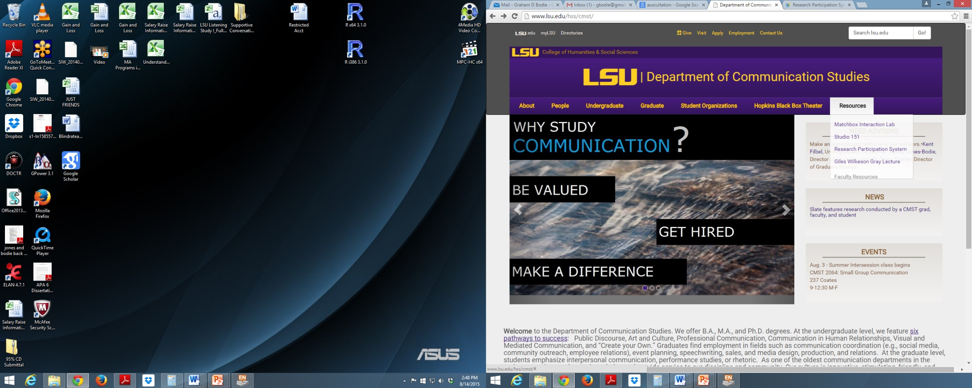

Slide 8
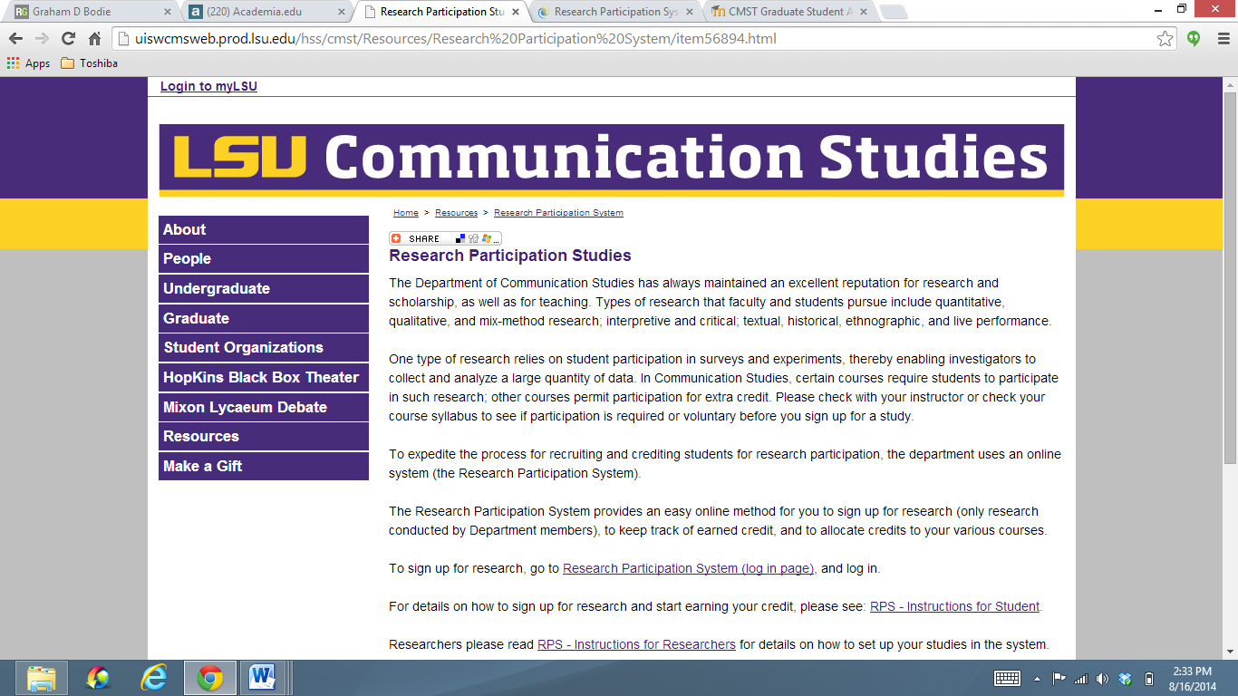

Slide 9
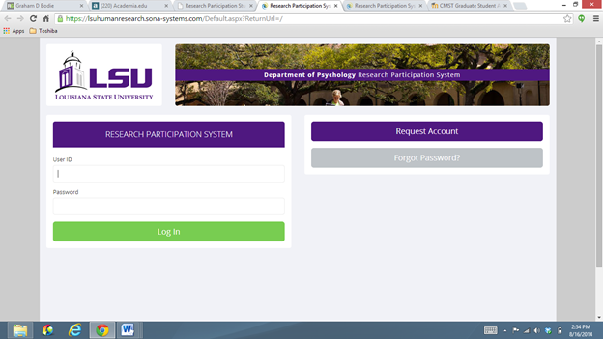
How do I sign up?
B. Log into the Research Participation System

Slide 10
For students WITH existing accounts
If you already have an account from a previous semester or from a course you took in the Department of Communication Studies or the Department of Psychology, you can continue to use that log in information.
Please note that other LSU departments also use Sona Systems for study signups. You will need an account specific to CMST/PSYC.
If you lost your information, click on the “Forgot Password?” link. (see above)
The first time you log in during a new semester, you will need to agree to the Human Subjects statement.

Slide 11
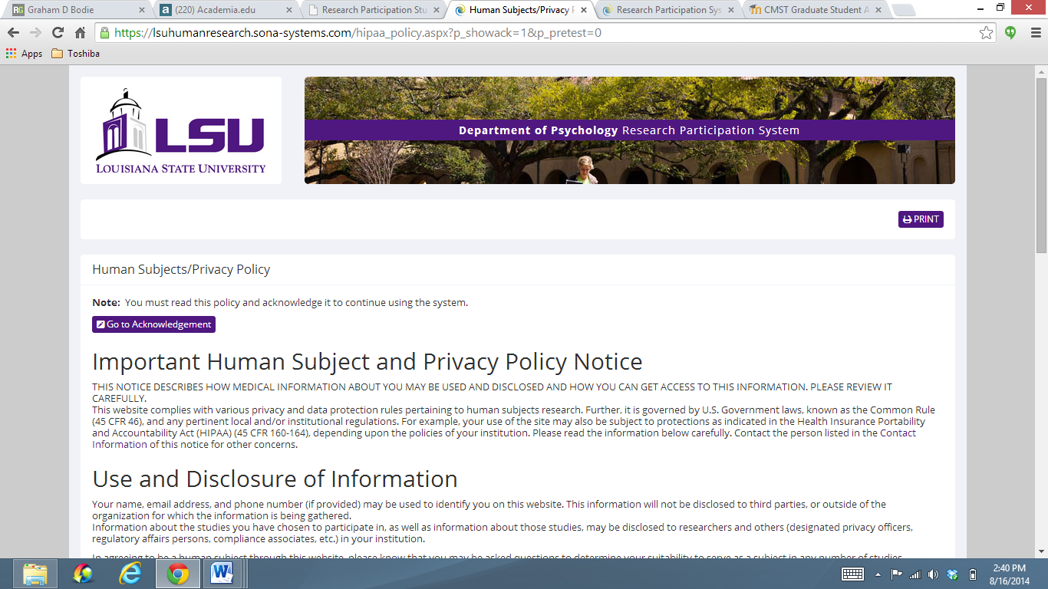
Human Subjects Policy

Slide 12
Potential Problem #1
If when you try to agree to the privacy policy it tells you that your authentication has expired and to log-in again, you have a problem with your web browser
Go to STUDENT INSTRUCTIONS, page 4!

Slide 13
For students WITH existing accounts
***CAREFULLY select your course or courses from the drop down box of CMST courses.
If you do not select a course, the system will not allow you to add credits to that course!
Please make sure you choose the CORRECT SECTION for the course/courses you are taking this semester. This is the primary problem that students have with the system – they are in one class then switch to another and their credits are then allocated to the wrong course.

Slide 14
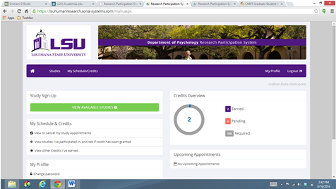
For students WITH existing accounts
To select your classes, click on MY PROFILE

Slide 15
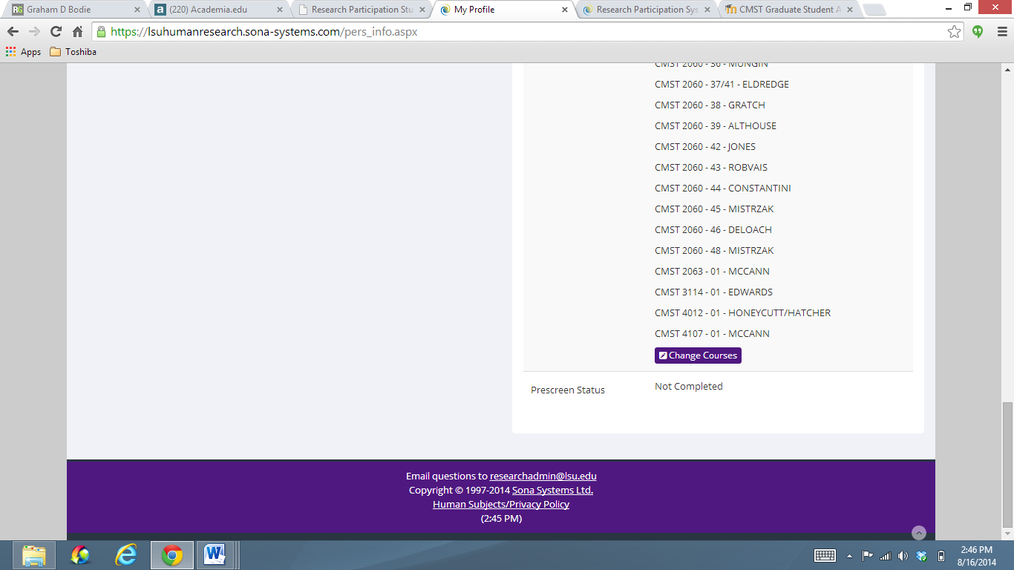
For students WITH existing accounts
Within MY PROFILE, you can “change” or “add” courses.

Slide 16
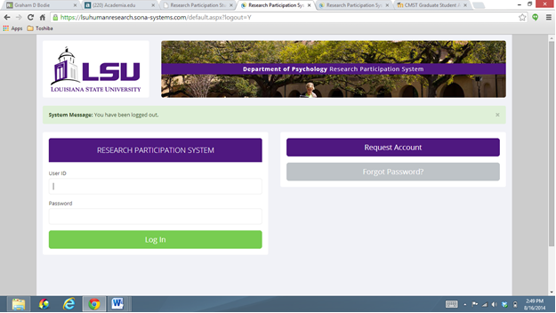
For students WITHOUT an existing account:
When you get to the RPS, you’ll need to first click the link on the top right of the log-in page that says: Request Account.

Slide 17
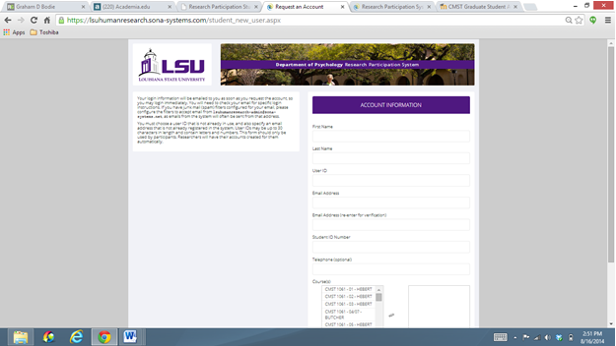
For students WITHOUT an existing account:
You will be asked to provide basic information. Your user ID is the first part of your LSU e-mail address, for example: cmststudent@lsu.edu. Fill in the required information:

Slide 18
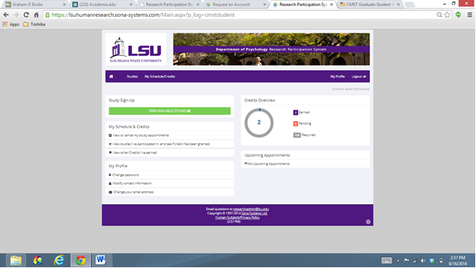
How do I start earning credits?
Log into the Research Participation System
Click on View Available Studies.

Slide 19
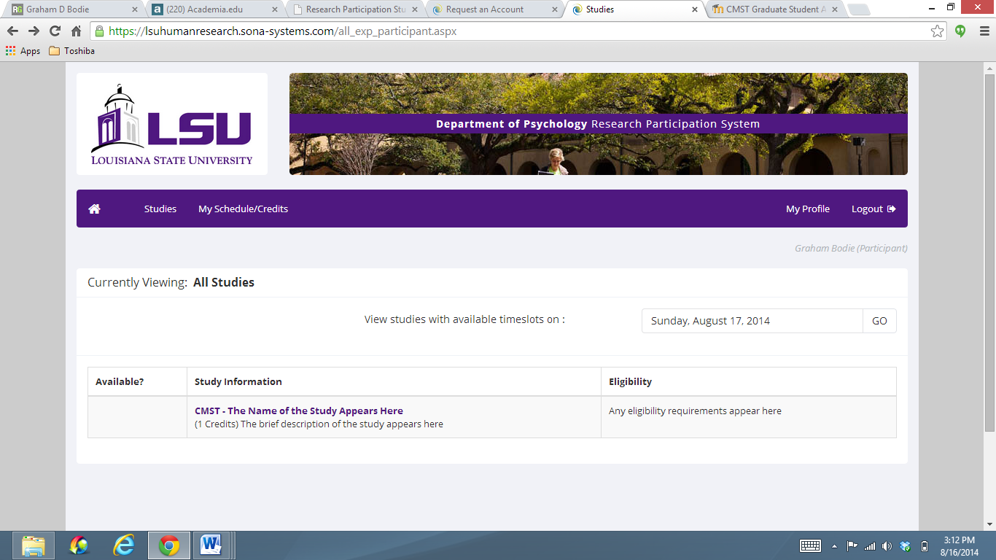
To sign up for an experiment, click on the experiment name to view more information

Slide 20
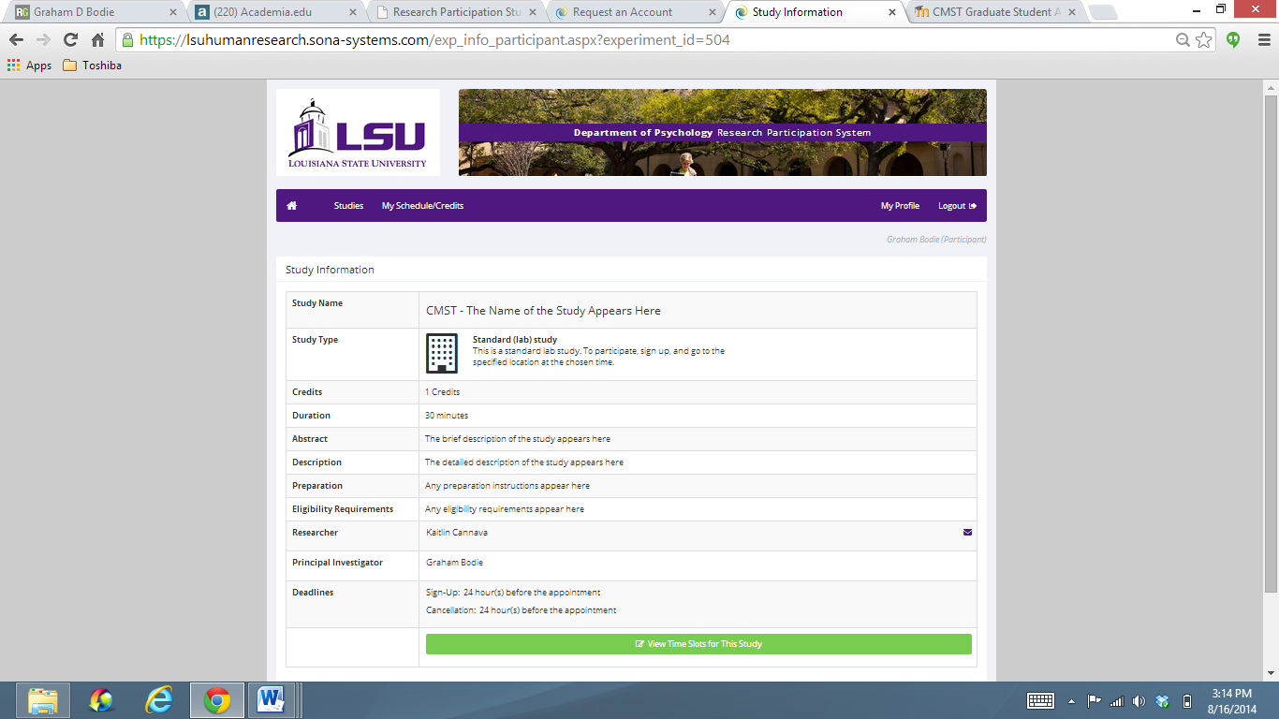
Read about the study and decide if you want to participate
View available time slots!

Slide 21
NOTE about studies
All studies have timeslots
For ONLINE studies, the timeslot is the last possible day and time that you can complete the study for credit
For other studies, the timeslot tells you when and where to show up to complete the study

Slide 22
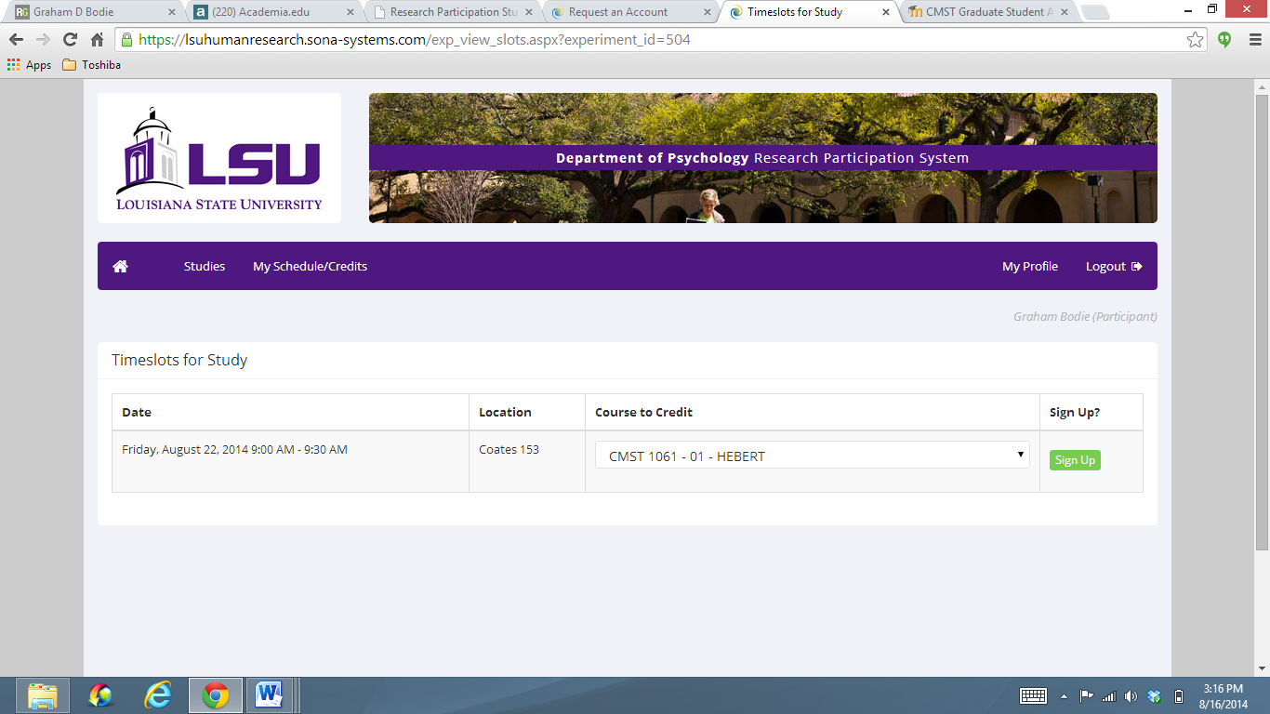
Choose the course that you want the credits to count towards and then click Sign Up (in green).

Slide 23
After you click Sign Up, you will see information displayed confirming the time and location of the study you plan to participate in. You will receive an email confirmation as well. You are now signed up for the study.
You will also receive an email reminder the day before the experiment, reminding you of the location and time of the experiment.

Slide 24
CANCEL if you cannot show up!
Be aware that if you fail to appear for two experiments without prior notification (see Canceling a Sign-Up Section), you will be sent an email informing you that you are restricted from completing any studies for the remainder of the semester. If you feel this email is in error, please contact the researcher in charge of the study with a university-approved excuse.

Slide 25
CANCEL if you cannot show up! Reassign credits if needed

Slide 26
Tracking your progress
To track your progress choose My Schedule/Credits option from the toolbar.
You will see the experiments that you have signed up for and the credit status for each, and how many credits you have earned for each course.
There is a cut-off date at the end of the semester (the Tuesday of dead week) by which all experiments must be completed in order to receive class credit.
Be sure to check your totals before the cut-off to ensure that your credits have been counted and make any changes you wish to your account.

Slide 27
Miscellaneous
Reassigning Credit: If you are in multiple CMST courses, you can reassign a credit from one course to another.
To do so, use the Reassign link that appears when you view your progress. The link appears under the course entry for each item in your progress listing.
Retrieving a Lost Password: If you have forgotten or do not have your password, you can click a link on the bottom left of the log in page that says: Lost Your Password-Click Here to Retrieve it. Your password will them be emailed to you.
Changing Your Password, Email Address, and Other Information To change your password or other information, choose My Profile from the toolbar on the main menu and the “update your profile” page will open. If you provide an alternate email address (e.g., Hotmail), this is where emails will be sent rather than to your LSU email.

Slide 28
Can I earn credit in another way?
In short, no.
Only departmental sanctioned events will count toward a student’s research learning requirement; thus, no credit will be given for a student attending an outside speaker or performance.

Slide 29
Can I earn extra credit?
In short, no.
This is a requirement for all students.
Professors MAY offer extra credit in other ways, but that is up to their discretion.
The Department does not promote the use of extra credit in its courses.

Slide 30
What do I get out of it?
The research learning requirement is worth 2% of your total grade
You will receive your 2% if you accumulate 2 research credits during the given semester.
Failure to complete your 2 credits earns you an F for 2% of your course grade.

